Slide 1
The Local Authority Response to the E4G M&E challenge with reference to Valleys Regional Park
Eleri Davies
Rheolwr Prosiect Treftadaeth Heritage Project Manager
Parc Rhanbarthol y Cymoedd Valleys Regional Park
Eleri.davies3@wales.gsi.gov.uk

Slide 2
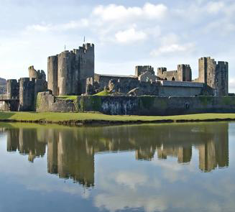
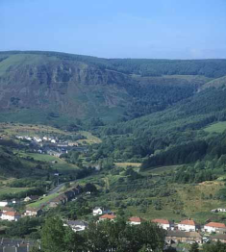
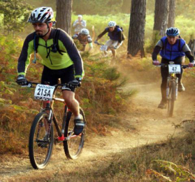
Valleys Regional Park : the concept and the project
Monitoring and evaluation requirements
Plans to meet the challenge
What next ?

Slide 3
VRP: Aims
Change the reality and perceptions of the Valleys as a highly-desirable place to live, work and visit
•Enhance and promote the Valleys’ outstanding environmental and cultural assets
•Create jobs and business based on the environment, culture and sustainable tourism
•Increased education and training opportunities
•Improve health through improved access to and usage of the countryside
•Develop strong, prosperous communities

Slide 4
VRP: Partnership
• Welsh Assembly Government (DE&T)
• Countryside Council for Wales
• Environment Agency Wales
• Forestry Commission Wales
• Visit Wales, WAG
• Capital Regional Tourism
• South West Wales Tourism Partnership
• Dwr Cymru/Welsh Water
• British Waterways
• Sports Council for Wales
• BTCV
• Keep Wales Tidy
• CADW
• National Museums of Wales
• Cynnal Cymru/Sustain Wales
• Dulais Valley Development Trust
• SEWTA
• SWWITCH
• FCGCF
• Groundwork Wales
• Groundwork Trusts
• Blaenau Gwent CBC
• Bridgend CBC
• Caerphilly CBC
• Cardiff CC
• Carmarthenshire CC
• Monmouthshire CC
• Merthyr Tydfil CBC
• Neath Port Talbot CBC
• Newport City Council
• Rhondda Cynon Taf CBC
• Swansea CC
• Torfaen CBC
• Brecon Beacons NPA
• Gwent Wildlife Trust
• Wildlife Trusts of South & West Wales
• RSPB
• Sustrans

Slide 5
VRP: ERDF Project
ERDF E4G convergence funding 2009-2012
Themes | Objectives
Transformational Landscapes for Visitors | Strategic landscape initiatives
Enhancing our visitor centres | Country parks, nature reserves
Loops and Links | Cycling, walking, riding - access
Community Pride Total Focus | Clean, pleasant environment
Community Tourism | Grassroots tourism
Training the ambassadors (ESF) | Trained Advocates
Events Programme | Additional attractions
Management and project delivery
TOTAL | £25.7m (gross)

Slide 6
Themes | Objectives
Transformational Landscapes for Visitors | Strategic landscape initiatives
Enhancing our visitor centres | Country parks, nature reserves
Loops and Links | Cycling, walking, riding - access
Community Pride Total Focus | Clean, pleasant environment
Community Tourism | Grassroots tourism
Training the ambassadors (ESF) | Trained Advocates
Events Programme | Additional attractions
Management and project delivery
TOTAL | £25.7m (gross)

Slide 7
Transforming landscapes / Enhancing our Visitor Centres
44 projects
Delivery 2010-2012
Examples;
Environmental enhancements
Climbing wall
Access improvements
Lakeside improvements
Gateways

Slide 8
Themes | Objectives
Transformational Landscapes for Visitors | Strategic landscape initiatives
Enhancing our visitor centres | Country parks, nature reserves
Loops and Links | Cycling, walking, riding - access
Community Pride Total Focus | Clean, pleasant environment
Community Tourism | Grassroots tourism
Training the ambassadors (ESF) | Trained Advocates
Events Programme | Additional attractions
Management and project delivery
TOTAL | £25.7m (gross)

Slide 9
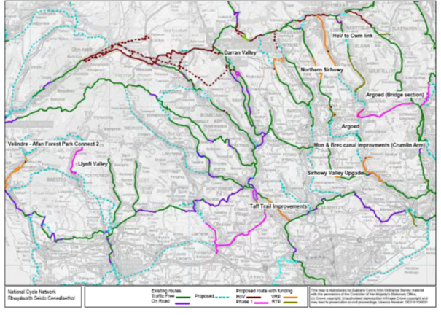
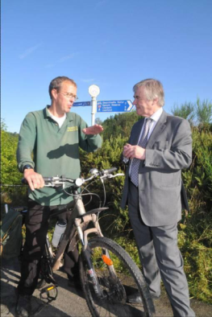
Valleys Cycle Network (VCN)
£5m gross investment via Sustrans

Slide 10
Themes | Objectives
Transformational Landscapes for Visitors | Strategic landscape initiatives
Enhancing our visitor centres | Country parks, nature reserves
Loops and Links | Cycling, walking, riding - access
Community Pride Total Focus | Clean, pleasant environment
Community Tourism | Grassroots tourism
Training the ambassadors (ESF) | Trained Advocates
Events Programme | Additional attractions
Management and project delivery
TOTAL | £25.7m (gross)

Slide 11
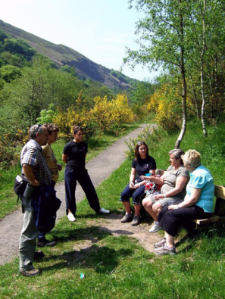
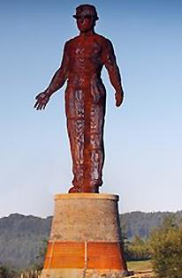
Community Tourism & Ambassadors
Events

Slide 12
VRP: Project Outputs
Primary Outputs | Programme Target | VRP Target
Initiatives Developing the Natural &/or Historic Environment | 21 | 6
Managed access to the Countryside | 15km | 80km
Primary Results Indicator
Visits | 196,000 | 100,000
Jobs Created | 5,000 | 200
Participants |  | 200
Qualifications |  | 150
Notes:
Why we are all here, because visits is easy, but job creation is hard.

Slide 13
VRP: M&E Requirements
Part of WERU contract, each E4G project must produce;
Visitor counts
1,200 completed surveys
500 Valleys Cycle Network
500 Visitor Centre Improvements
200 Events
Site energy returns

Slide 14
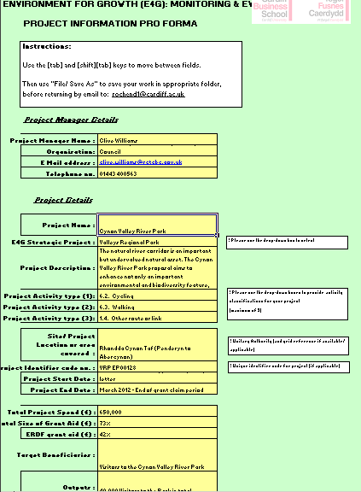
Therefore, each VRP project must produce;
Project flyer
Visitor counts over one calendar year
Contribution to 1,200 completed surveys
Site energy returns, where applicable
Grant conditional on;
‘Your commitment to contribute to the monitoring & evaluation plan for the project, co-ordinated by the Welsh Economy Research Unit (guidance available at www.e4g.org.uk);’
Notes:
Minimum eighteen days- most JPS chosen automatic counters.

Slide 15
VRP: Plans to meet challenge
Project sponsors invited to M&E day in March 2010
One representative per Local Authority
Feedback from that showed that individual sessions were needed.
Surgery day held June 2010 with most
project sponsors
Notes:
Day constrained by time so chosen LAs with most projects. Grouped others in where made sense, e.g. FCW. Others know and will get the same level of service.

Slide 16
VRP: Surgery Day
All relevant staff from Local Authority invited
Limited time per LA
Expectation that each LA had visited the website before attending
Each project taken in turn
Aims:
Confirm commitments to collect (or commission) counts
Confirm sites to do surveys at
Confirm baseline situation
Stress importance of getting information to WERU, and in what format
Raise profile of the web forum
Confirm lines of communication
Notes:
All LA reps for events, interpretation, capital present and future projects.
Took the risk that we could allow LAs to nominate their site for surveys.

Slide 17
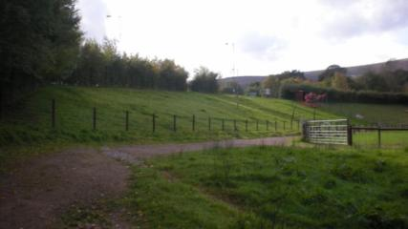
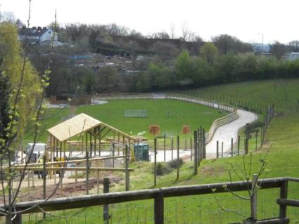
VRP: Torfaen example
Nine projects: 5 capital, 3 events and 1 interpretation
Greenmeadow Community Farm
– upgrade the Eye paddock & renovate the Haybarn
Ticketed venue gives baseline
Ticket sales gives visitor counts
Works completed 2010
Calendar year for counts 2011
Separate energy supply for site energy return
Dedicated staff to collect information.
Notes:
Surveys to be completed at Blaenavon WHS instead.

Slide 18
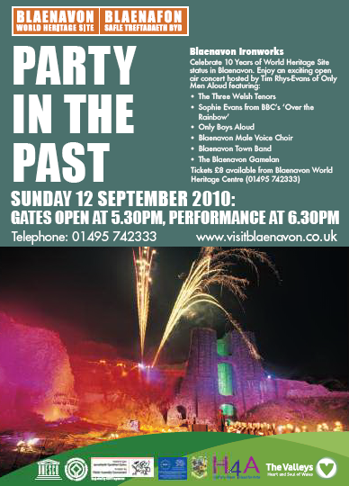
VRP: Torfaen example
Nine projects: 5 capital, 3 events and 1 interpretation
World Heritage 10th Anniversary Event
- One off event – no baseline
Green badge guides used to collect surveys
Ticket sales gives visitor counts
Notes:
WERU happy to approve variant questionnaires.

Slide 19
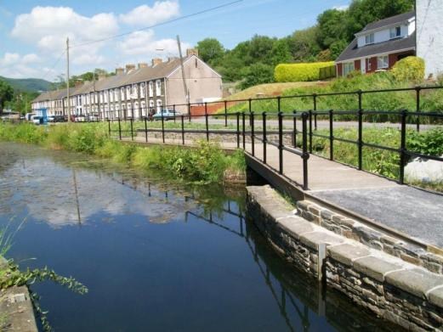
VRP: Neath Port Talbot example
Six projects: 3 capital, 1 event, 2 interpretation
Cyd Terrace/Ynysbwllog Aqueduct
- Environmental improvements / new footbridges / improved paths and seating area
No baseline
Car park counters installed and automatic counters on new paths
Site energy not applicable
Surveys not applicable
Notes:
NPTCBC opted to collect surveys at Gnoll Estate Country Park instead, where there is a visitor centre.

Slide 20
VRP: Neath Port Talbot example
Gnoll Estate Interpretation
Interpretation on site of some capital works.
Capital works relate to upgrading of paths for people with disabilities, and lease of Beamer Trampers
STEAM baseline
How to distinguish visitors for interpretation and visitors to beamer trampers?
Beamer tramper counts vs. additional visitor counters on site relate to wider improved visitor offer
Site energy not applicable
Surveys at visitor centre- self completion
.
Gnoll Estate Country Park
Notes:
NPTCBC opted to collect surveys at Gnoll Estate Country Park instead, where there is a visitor centre.

Slide 21
VRP: Common misconceptions
“ Do we have to fill all the forms in ? “
Surveys at nominated sites only
Existing questionnaires can be used
100 surveys per LA
Requirement for data input
Visitor counts capital vs. interpretation
Site energy form when makes sense.
Notes:
All sites would need to collect survey information
Existing questionnaires could not be used
Need to distinguish between visitors coming to new cycle route or interpretation board next to it.
WERU will input the data
- Each LA needs to provide more than 100 surveys.

Slide 22
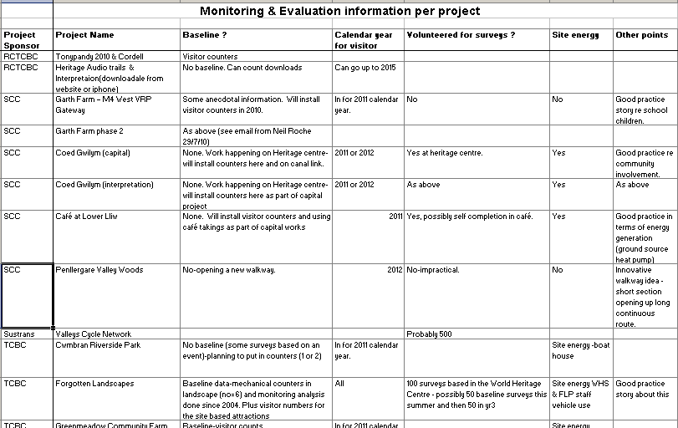
VRP: Results from surgery day
Notes:
Plus good practice examples to help tell the story and stop final report being dry.
Dare Valley, and Six Bells done surveys. Plus surveys at WHC in Blaenavon.

Slide 23
VRP: Remaining issues
- How to deal with interpretation where it isn’t linked to capital project
Need to repeat process for future projects
Community projects:
resources
spreading the message
Ongoing reassurance
Notes:
Do the community groups have the resources, and how to reach them all easily.

Slide 24
Thank you!!
Eleri Davies
Eleri.davies3@wales.gsi.gov.uk
01443 335647

