Slide 1
Environment for Growth
Neil Roche
Survey Insights and the E4G Website

Slide 2
Requirements of E4G M&E
Visitor volume measurement
Site Energy measurement
….And for a selection of initiatives- Visitor Survey

Slide 3
Visitor Survey
Preparing for the survey
Organizing and briefing survey teams
Carrying out the fieldwork
Challenges
Your experiences?

Slide 4
Preparing for the Survey
Health and Safety considerations
Let someone know where you are going, and what time you expect to return
Take your mobile phone with you
Clothing & footwear appropriate to weather and terrain
Check the weather forecast
Ensure access to sufficient food & water
Beware of domestic and farm animals
Remote areas plan escape route
Take a colleague if you can

Slide 5
Surveying Teams
Briefing session
  Talk through logistics, surveying, meeting times etc.
  Go through the questionnaire form
  Deal with any concerns of the surveyors
Instructions Handout [see example]

Slide 6
Equipment
A supply of survey forms
Clipboard
Spare pens
Mobile phone
A letter from the initiative manager briefly setting out reason for doing the survey and including office contact details in case more information wanted

Slide 7
Carrying out Survey work
There is no single, ideal method; site and visit characteristics or resource available might dictate a certain approach
Face to face random site survey
  For sites which favour survey work at various points or at designated entry/exit points
  Visitors are stopped at particular areas/points within a site using an established sampling technique: e.g. ask every 4th group
Face to face hotspot survey
  For sites with single point(s) at which visitors congregate or pass, such as visitor centres or cafés
  Visitors are interviewed at particular points within a site using an established sampling technique

Slide 8
Challenges?
The “lazy” surveyor
  If possible survey manager should patrol to monitor; offer encouragement
  During the day get the interviewers together to find out how progressing and have them shout out how many surveys they’ve done
The “creative” surveyor (self-completion to boost numbers)
  Tell survey team at start that using statistical analysis it is easy to identify where this has taken place, and they will be found out
  Survey manager should patrol to monitor

Slide 9
Visitor surveys
Any Questions?
Your visitor survey experiences?

Slide 10
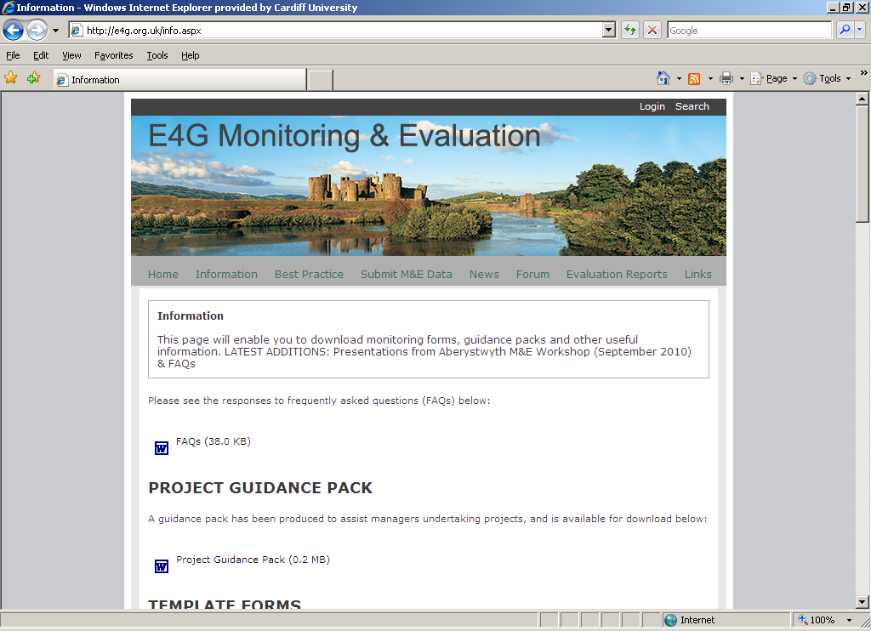
The E4G website www.e4g.org.uk
:

Slide 11
Website Information
Copies of forms to download:
  Frequently asked questions (FAQs)
  E-flyers
  Visitor Volume count forms
  Site Energy monitoring form
  Visitor Survey
  Presentations from workshop days

Slide 12
Website – Submit M&E data
You can submit Monitoring and Evaluation information by clicking on the website link and attaching any documents to the generated email.
As well as the core M&E data (visitor volumes, energy returns and visitor surveys) can also submit any interesting E4G related news stories

Slide 13
Website - other
The website also provides:
  Information on best practice (e.g. evaluation reports from Objective 1 programme in Wales 2000-06)
  Latest news on E4G monitoring and evaluation
  A forum for those involved to exchange experiences/ ask questions
  Links to other sites e.g. Wales Council for Voluntary Action
  Evaluation reports on progress will be posted

Slide 14
E4G Monitoring and Evaluation
www.e4g.org.uk
Neil Roche rochend1@cardiff.ac.uk

